Slide 1

Exploited CVEs of 2025:
Lessons for Vendors and Defenders
Patrick Garrity
(Security Researcher @ VulnCheck)

Slide 2

SECURITY RESEARCH
CNA

Slide 3
Transparent as Possible About Exploitation

Slide 4
Are You Doing Business in the EU?

Slide 5
Manufacturers should undertake an assessment of the cybersecurity risks associated with a product with digital elements to identify relevant risks and relevant essential cybersecurity requirements in order to make available their products with digital elements without known exploitable vulnerabilities that might have an impact on the security of those products and to appropriately apply suitable harmonised standards, common specifications or European or international standards.

Slide 6
Vulnerability
Growth Trends

Slide 7


Slide 8

CVE Growth 2020-2024
# of CVEs Published
CVE Publish Year

Slide 9
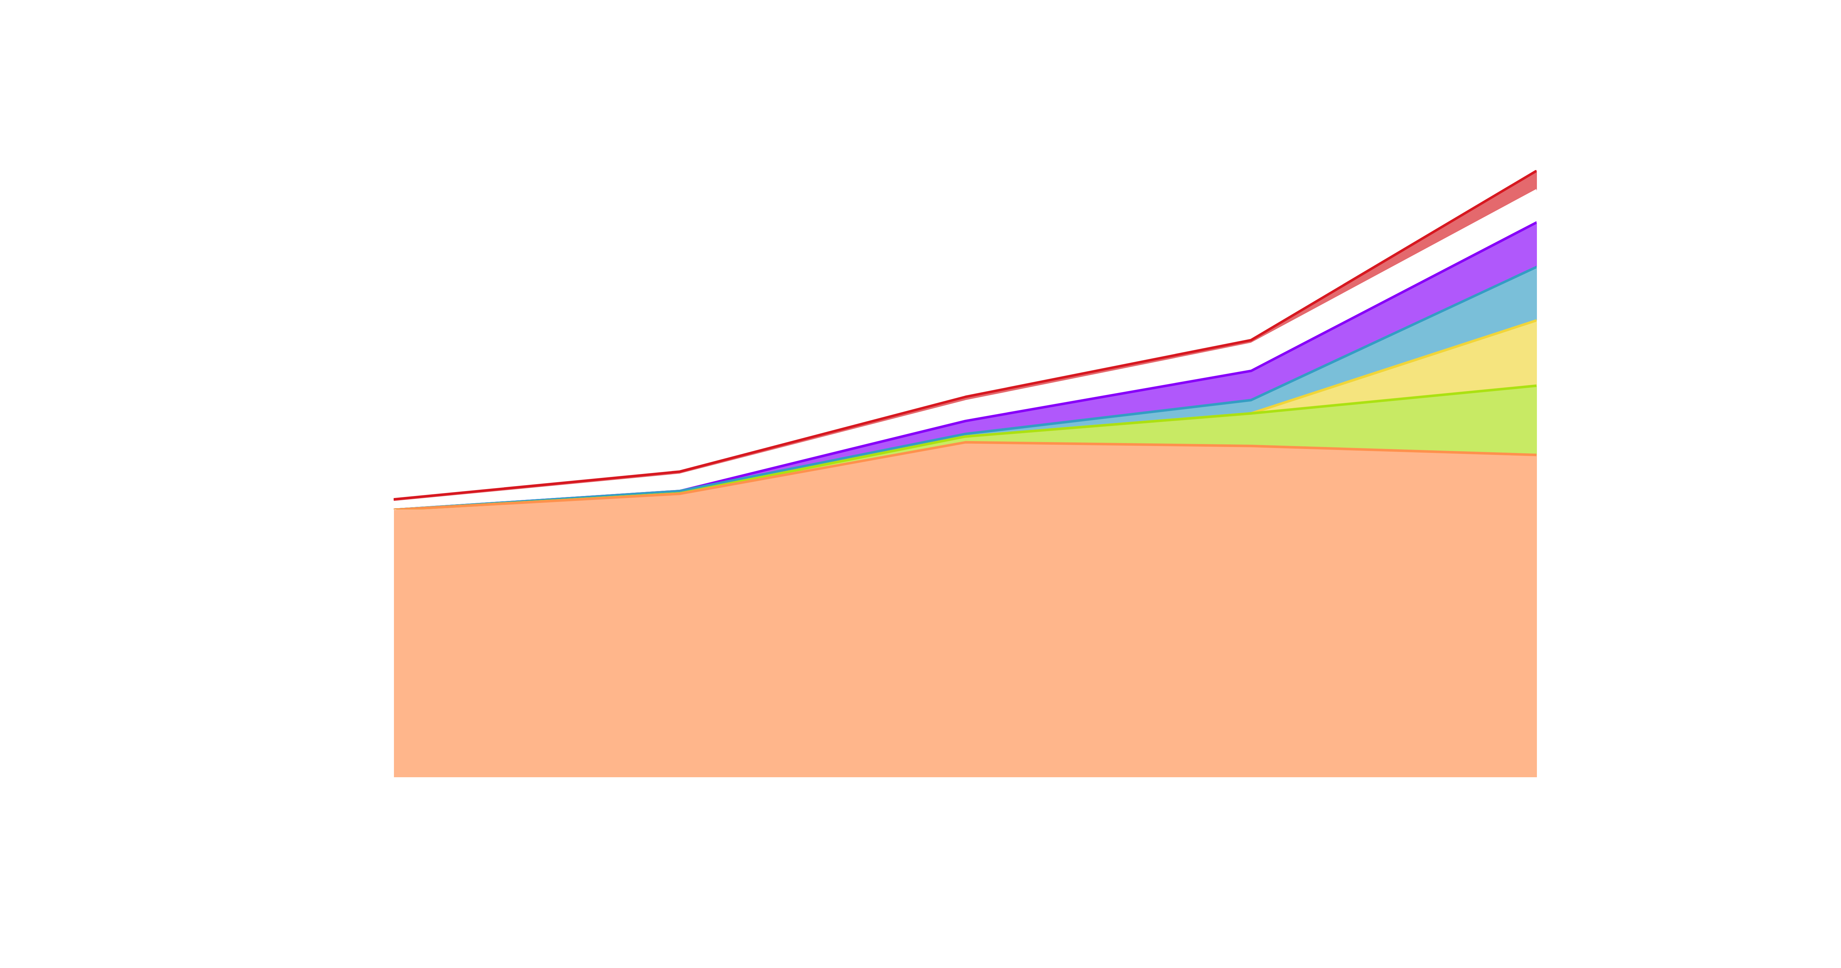
What is Behind the Exponential Growth of CVEs?
(Wordpress)
(Linux)
(Wordpress)
(Misc)
(Open Source)
(Bug Bounty)
# of CVEs Published
CVE Publish Year

Slide 10
Known Exploited
Vulnerability Trends

Slide 11

Vulnerability Threat Matrix
Ransomware
Botnet
Known Exploited
Threat Actor (APT)
Unattributed KEV
Weaponized
Exploit Availability
Proof-of-Concept
All Other CVEs
Notes:
Exploited by Threat Actors who previously targeted my Organization
Exploited by Threat Actors who previously targeted similar Organizations
Exploited by Threat Actors (APT, Ransomware, Botnets)
Known Exploited In-the-Wild (ITW) [i.e., exploited by unknown parties]
Exploit Weaponization (i.e., in MetaSploit, in commercial or public/private Exploit Kits)
Exploit Proof of Concept Code available (RCE, LPE)
Code available that crashes the service
Very recent CVE (past week) which is very similar to past CVEs that are above (i.e., QNAP Command Injection released)
All CVEs

Slide 12
Known Exploited Vulnerabilities
Not Just CISA KEV

Slide 13





How are we defining KEV?
We include any vulnerability publicly-reported as exploited in the wild. It’s Free!
Automated collection & Third Party Reporting that is Currated by security reasearch.
Trusted Sources
Automated KEV

Slide 14
Important Details about KEVs
Emerging Threat (Fix Fast)
Evidence is all Public Record
If there is no CVE > Coordinate to get a CVE issued timely
Work Closely with other Intel firms on vulnerability / exploitation disclosure
There are many ways people define exploitation differently

Slide 15
What Does This Research Include?
Exploitation that was disclosed for the first time in 2025-1H.
432+ Known Exploited Vulnerabilities
914+ KEV Reference Citations*
30 Known Ransomware
Dates = When First Evidence was published

Slide 16
How the Year Started

Slide 17








VULNCHECK KEV CONFIRMED EXPLOITATION
2025 YEAR-TO-DATE (01/01-01/15/2025)
01/02
01/07
01/07
01/08
01/08
Xiaomi Mi
WiFi R3G
Aviatri
Controller
Mitel
MiCollab
Ivanti
Connect Secure
Ivanti
Connect Secure
1/13
CVE-2019-18371
Source: Shadow Server
CVSS-BT: 7.5
EPSS: 3.37%
CVE-2024-50603
Source: Aviatrix / Wiz
CVSS-BT: 10
EPSS: 0.96%
CVE-2024-55550
Source: CISA
CVSS-BT: 4.4
EPSS: 42.71%
CVE-2025-0282
Source: Ivanti
CVSS-BT: 9
EPSS: 15.33%
CVE-2025-0283
Source: NCSC
CVSS-BT: 7
EPSS: 0.04%
Repetier
Server
CVE-2023-31059
Source: Shadow Server
CVSS-BT: 7.5
EPSS: 1.89%
1/14
1/14
1/14
1/14
?
Microsoft
Windows Hyper-V
Microsoft
Windows Hyper-V
Microsoft
Windows Hyper-V
Fortinet
FortiOS
?
CVE-2025-21335
Source: Microsoft
CVSS-BT: 7.8
EPSS: 0.14%
CVE-2025-21334
Source: Microsoft
CVSS-BT: 7.8
EPSS: 0.14%
CVE-2025-21333
Source: Microsoft
CVSS-BT: 7.8
EPSS: 0.14%
CVE-2024-55591
Source: Fortinet
CVSS-BT: 9.8
EPSS: 1.18%
?

Slide 18
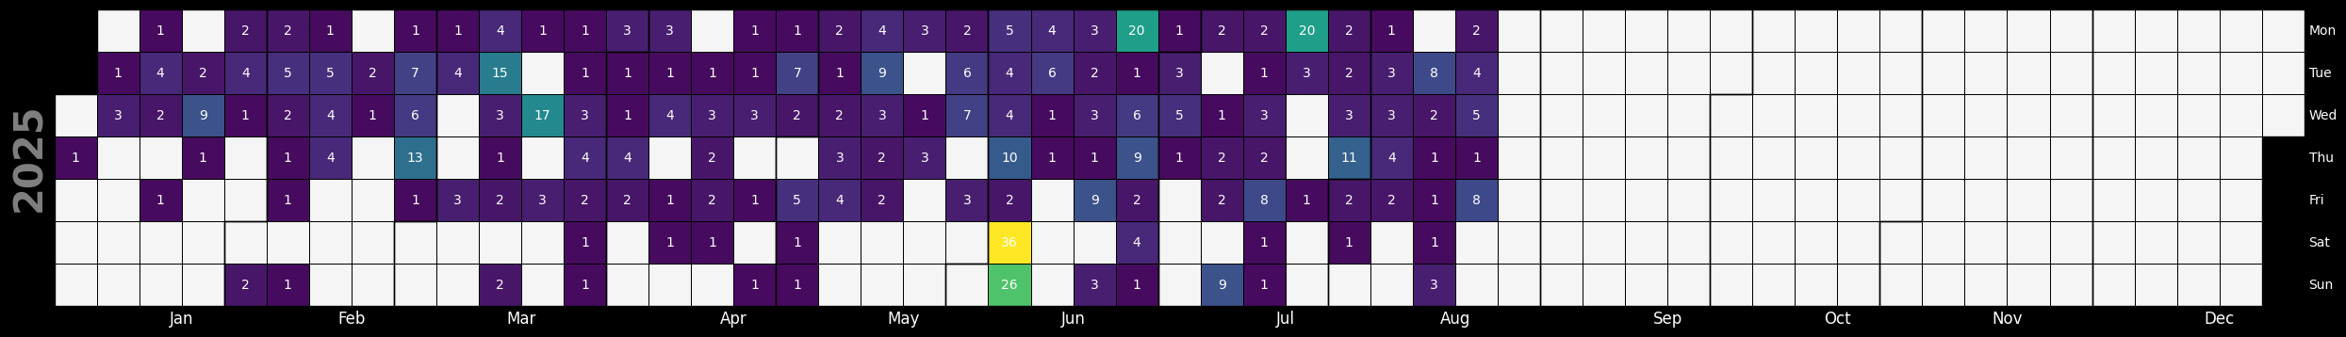

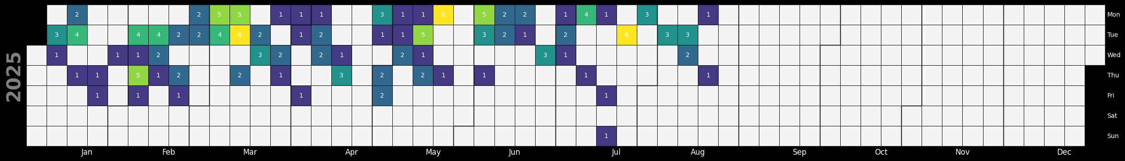
VulnCheck KEV
CISA KEV
Source: VulnCheck

Slide 19
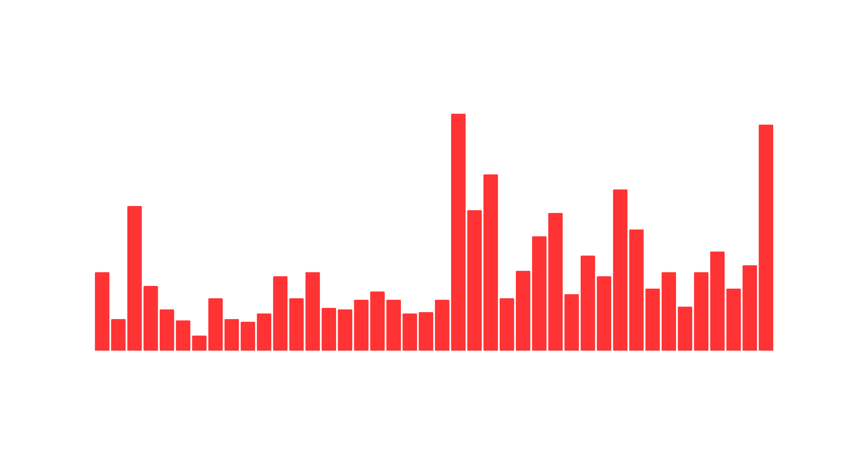

Q1-2025 Known Exploited Vulnerabilities
Source: VulnCheck KEV
# of New KEVs
Month

Slide 20





































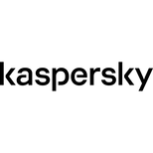






Earliest Reporter of
Exploitation in the Wild
Source: VulnCheck KEV (1H-2025)
Fearsoff
Sekoia
Cofense
Reliaquest
NCSC
Forescout
Qianxin
rt-security
Aviatrix
Gladinet
Security
Week
The
Hacker
News
Olegzay
KB CERT
Kevintel
Japan
Vulnerability
Notes
Onapsis
Chocapikk
NCC
Group
Hunter
Strategy
WPscan
Falcon
Feeds
Sensepost
Step
Security
CERT
PL
Horde
Cyberreason

Slide 21

CVE Assignment for Exploited Vulns
57 detections w/o CVEs analyzed
3 detections deemed non-CVEable (well-documented, non-default configs/features)
35 CVEs assigned
28 CVEs correlated

Slide 22
Let’s Look at a KEV

Slide 23







LANGFLOW AI COORDINATED DISCLOSURE
DISCOVERED BY HORIZON3.AI | CVE-2025-3248 | LANGFLOW AI
02/22
02/24
02/25
2/26
3/5
Vulnerability Reported to Langflow
Escalated Through Github Issue
Escalated Through HackerOne to DataStax
Escalated Through Email to Datastax (Acknowledged)
PR Fix Merged
Action: LangFlow AI
3/10
Action: Horizon3.ai
Action: Horizon3.ai
Action: Horizon3.ai
Action: Horizon3.ai
Request CVE
from Mitre
Action: Horizon3.ai
4/3
4/2
4/1
3/31
3/17
VulnCheck
Assigns CVE
Request CVE
from VulnCheck
Follow-up with Mitre for CVE
Fix Version Released
HackerOne
Responds
4/7
Action: VulnCheck
Action: Horizon3.ai
Action: Horizon3.ai
Action: LangFlow AI
(Already Fixed)
VulnCheck
Publishes CVE
4/7
4/9
4/12
5/5
Action: VulnCheck
Request to Cancel CVE Request
Exploit
Published
Exploitation Confirmed
Added to
CISA KEV
Action: Horizon3.ai

Slide 24
How Quickly are Vulnerabilities Being Exploited?

Slide 25

1H-2025 Known Exploited Vulnerabilities (432)
Time From CVE to Exploitation Evidence
Source: VulnCheck KEV
< 1 Day
139 (32.1%)
1 - 31 Days
38 (8.78%)
32 - 365 Days
95 (21.94%)
1-2 Year
44 (10.16%)
2-4 Years
55 (12.70%)
4+ Years
60 (13.86%)
Unpublished 1 (.23%)
Rejected 1 (.23%)

Slide 26
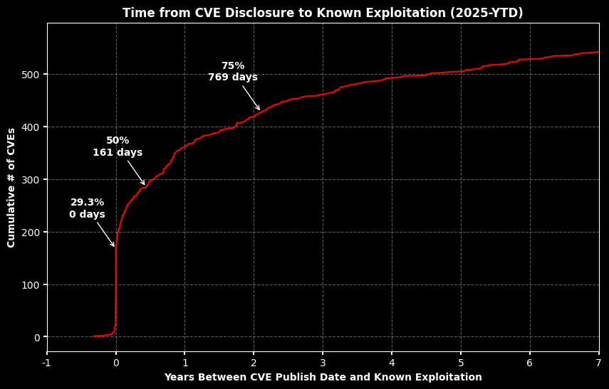

Slide 27
KEV Categorization

Slide 28
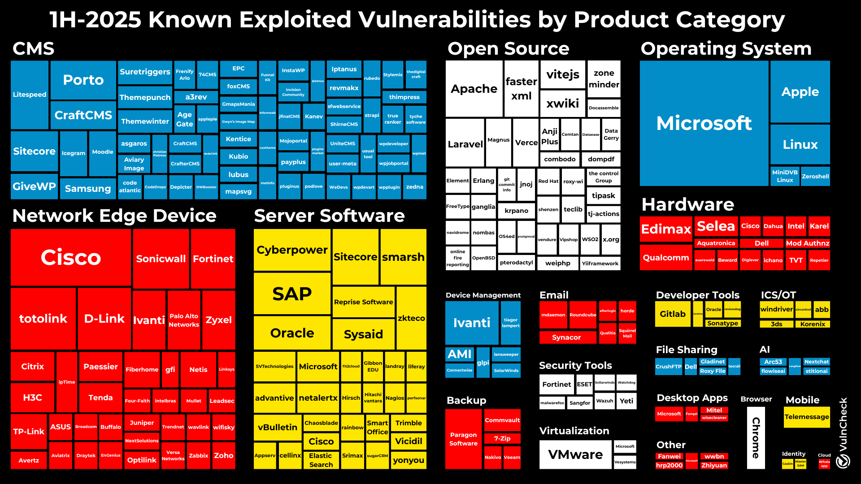

Slide 29
Ransomware

Slide 30
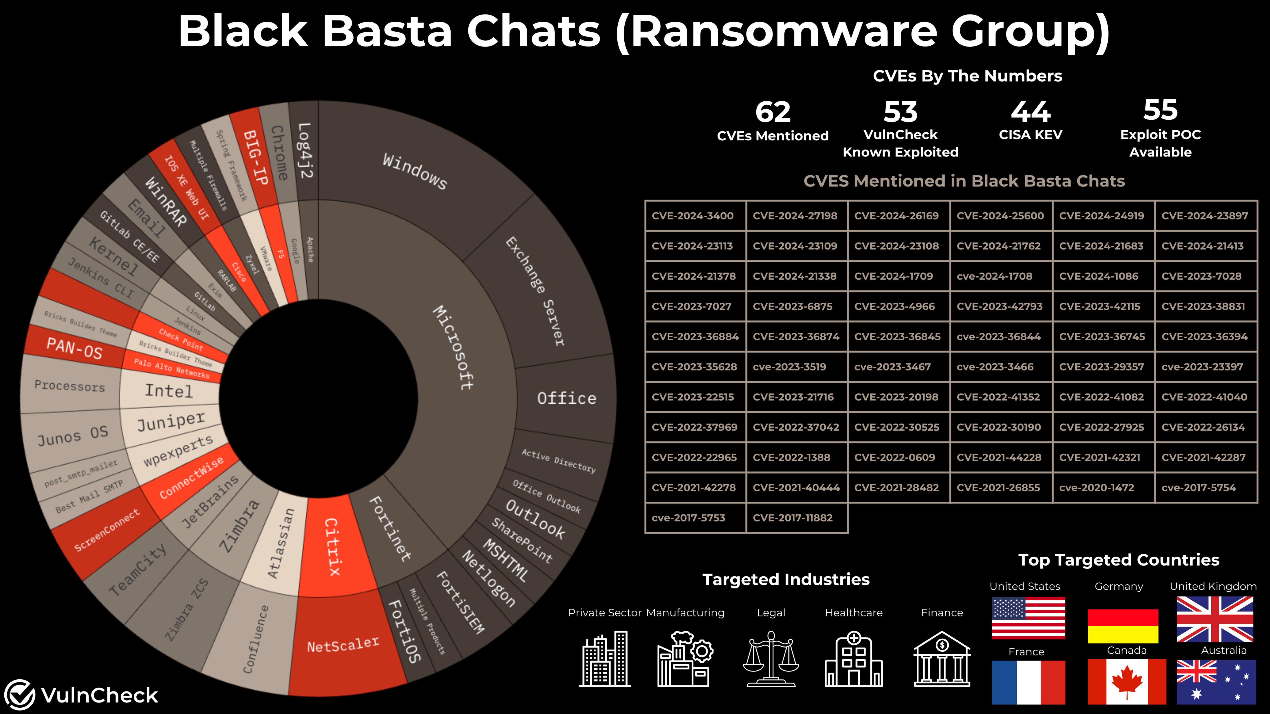

Slide 31
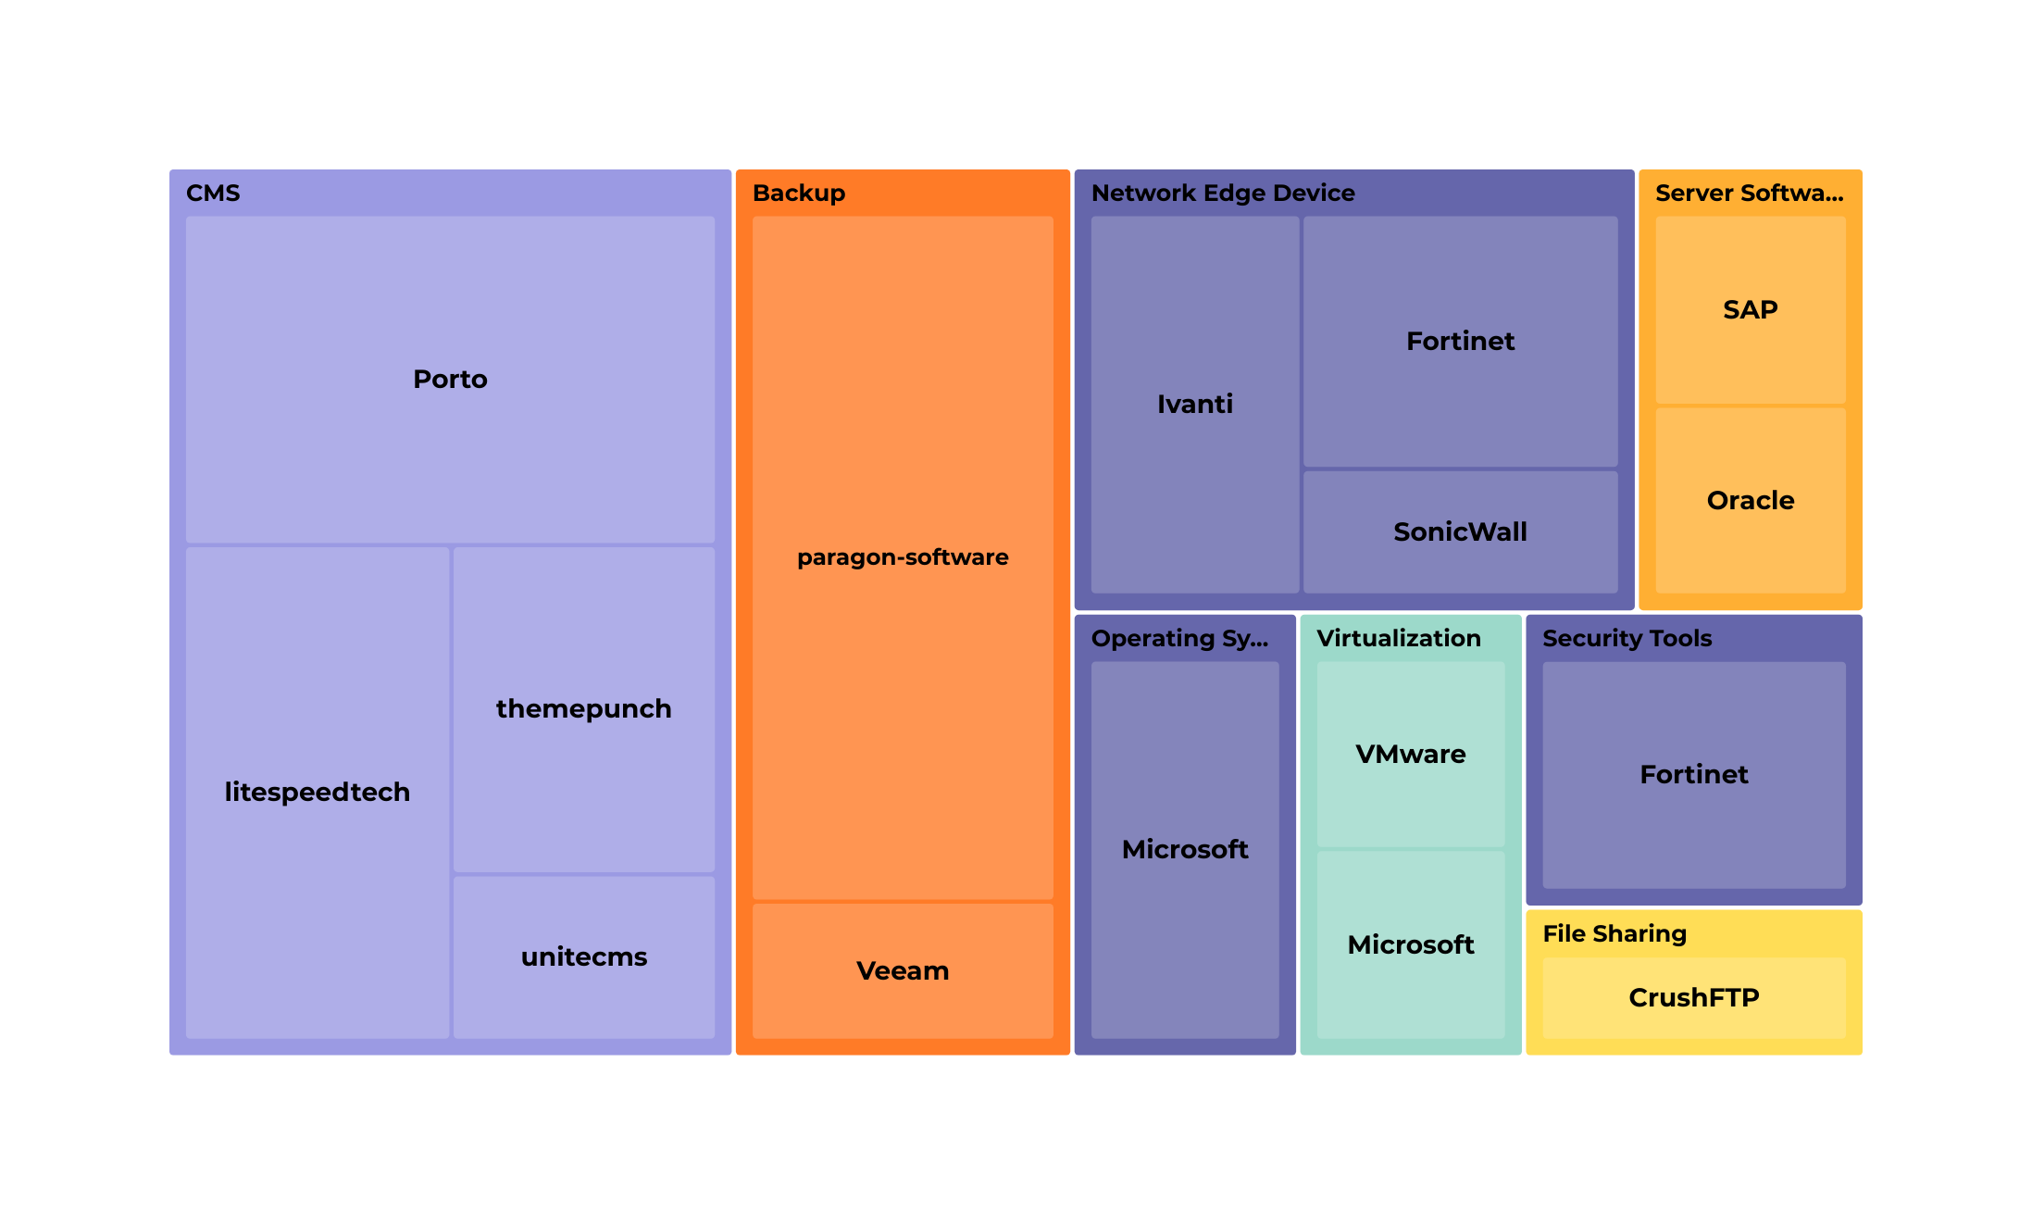
Ransomware Associated KEVs

Slide 32
Threat Actors

Slide 33











1H-2025 # of Unique Threat Actors Attributed by Country
North Korea
Iran
China
Russia
Turkey
Belarus
Palestine
India
Vietnam
Israel
UAE

Slide 34
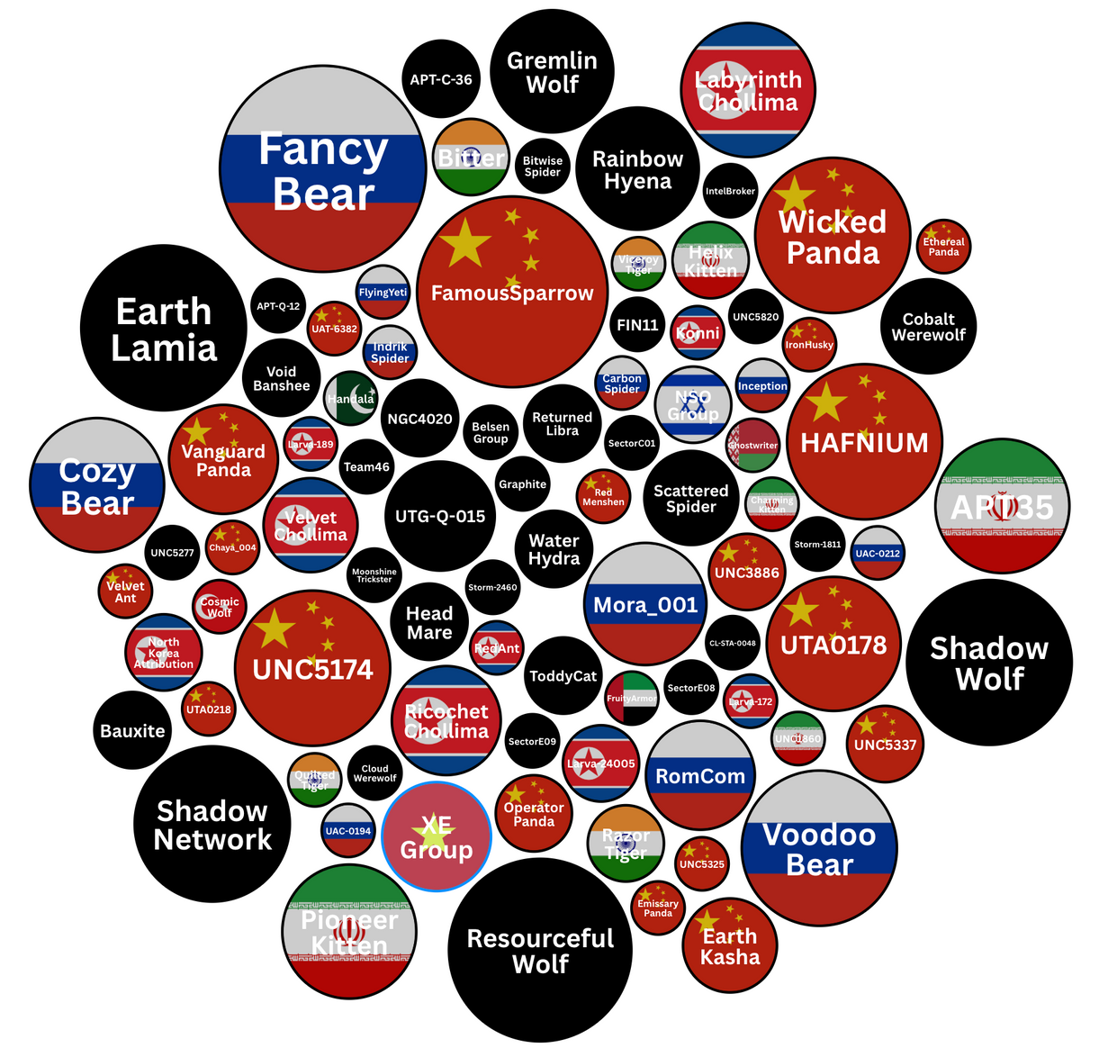
Threat Actor Attribution
# of Unique CVEs in 1H-2025
Source: VulnCheck Exploit Intelligence

Slide 35
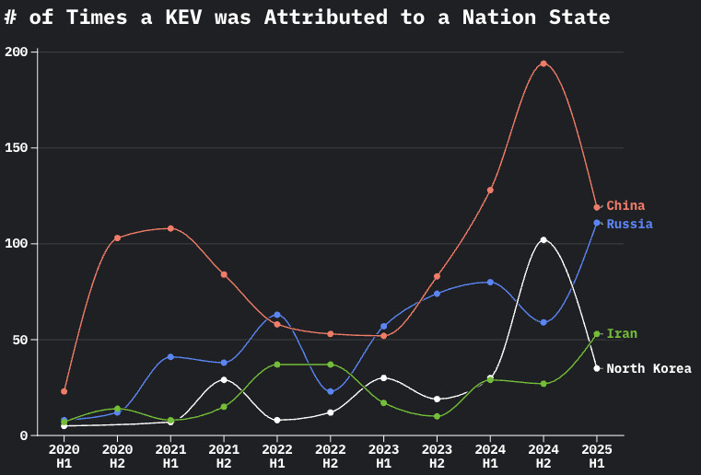

Slide 36
Vulnerability
Scoring Systems

Slide 37
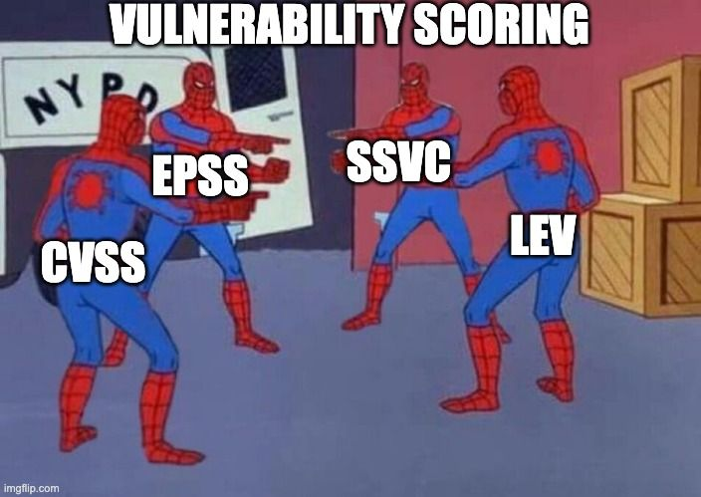

Slide 38
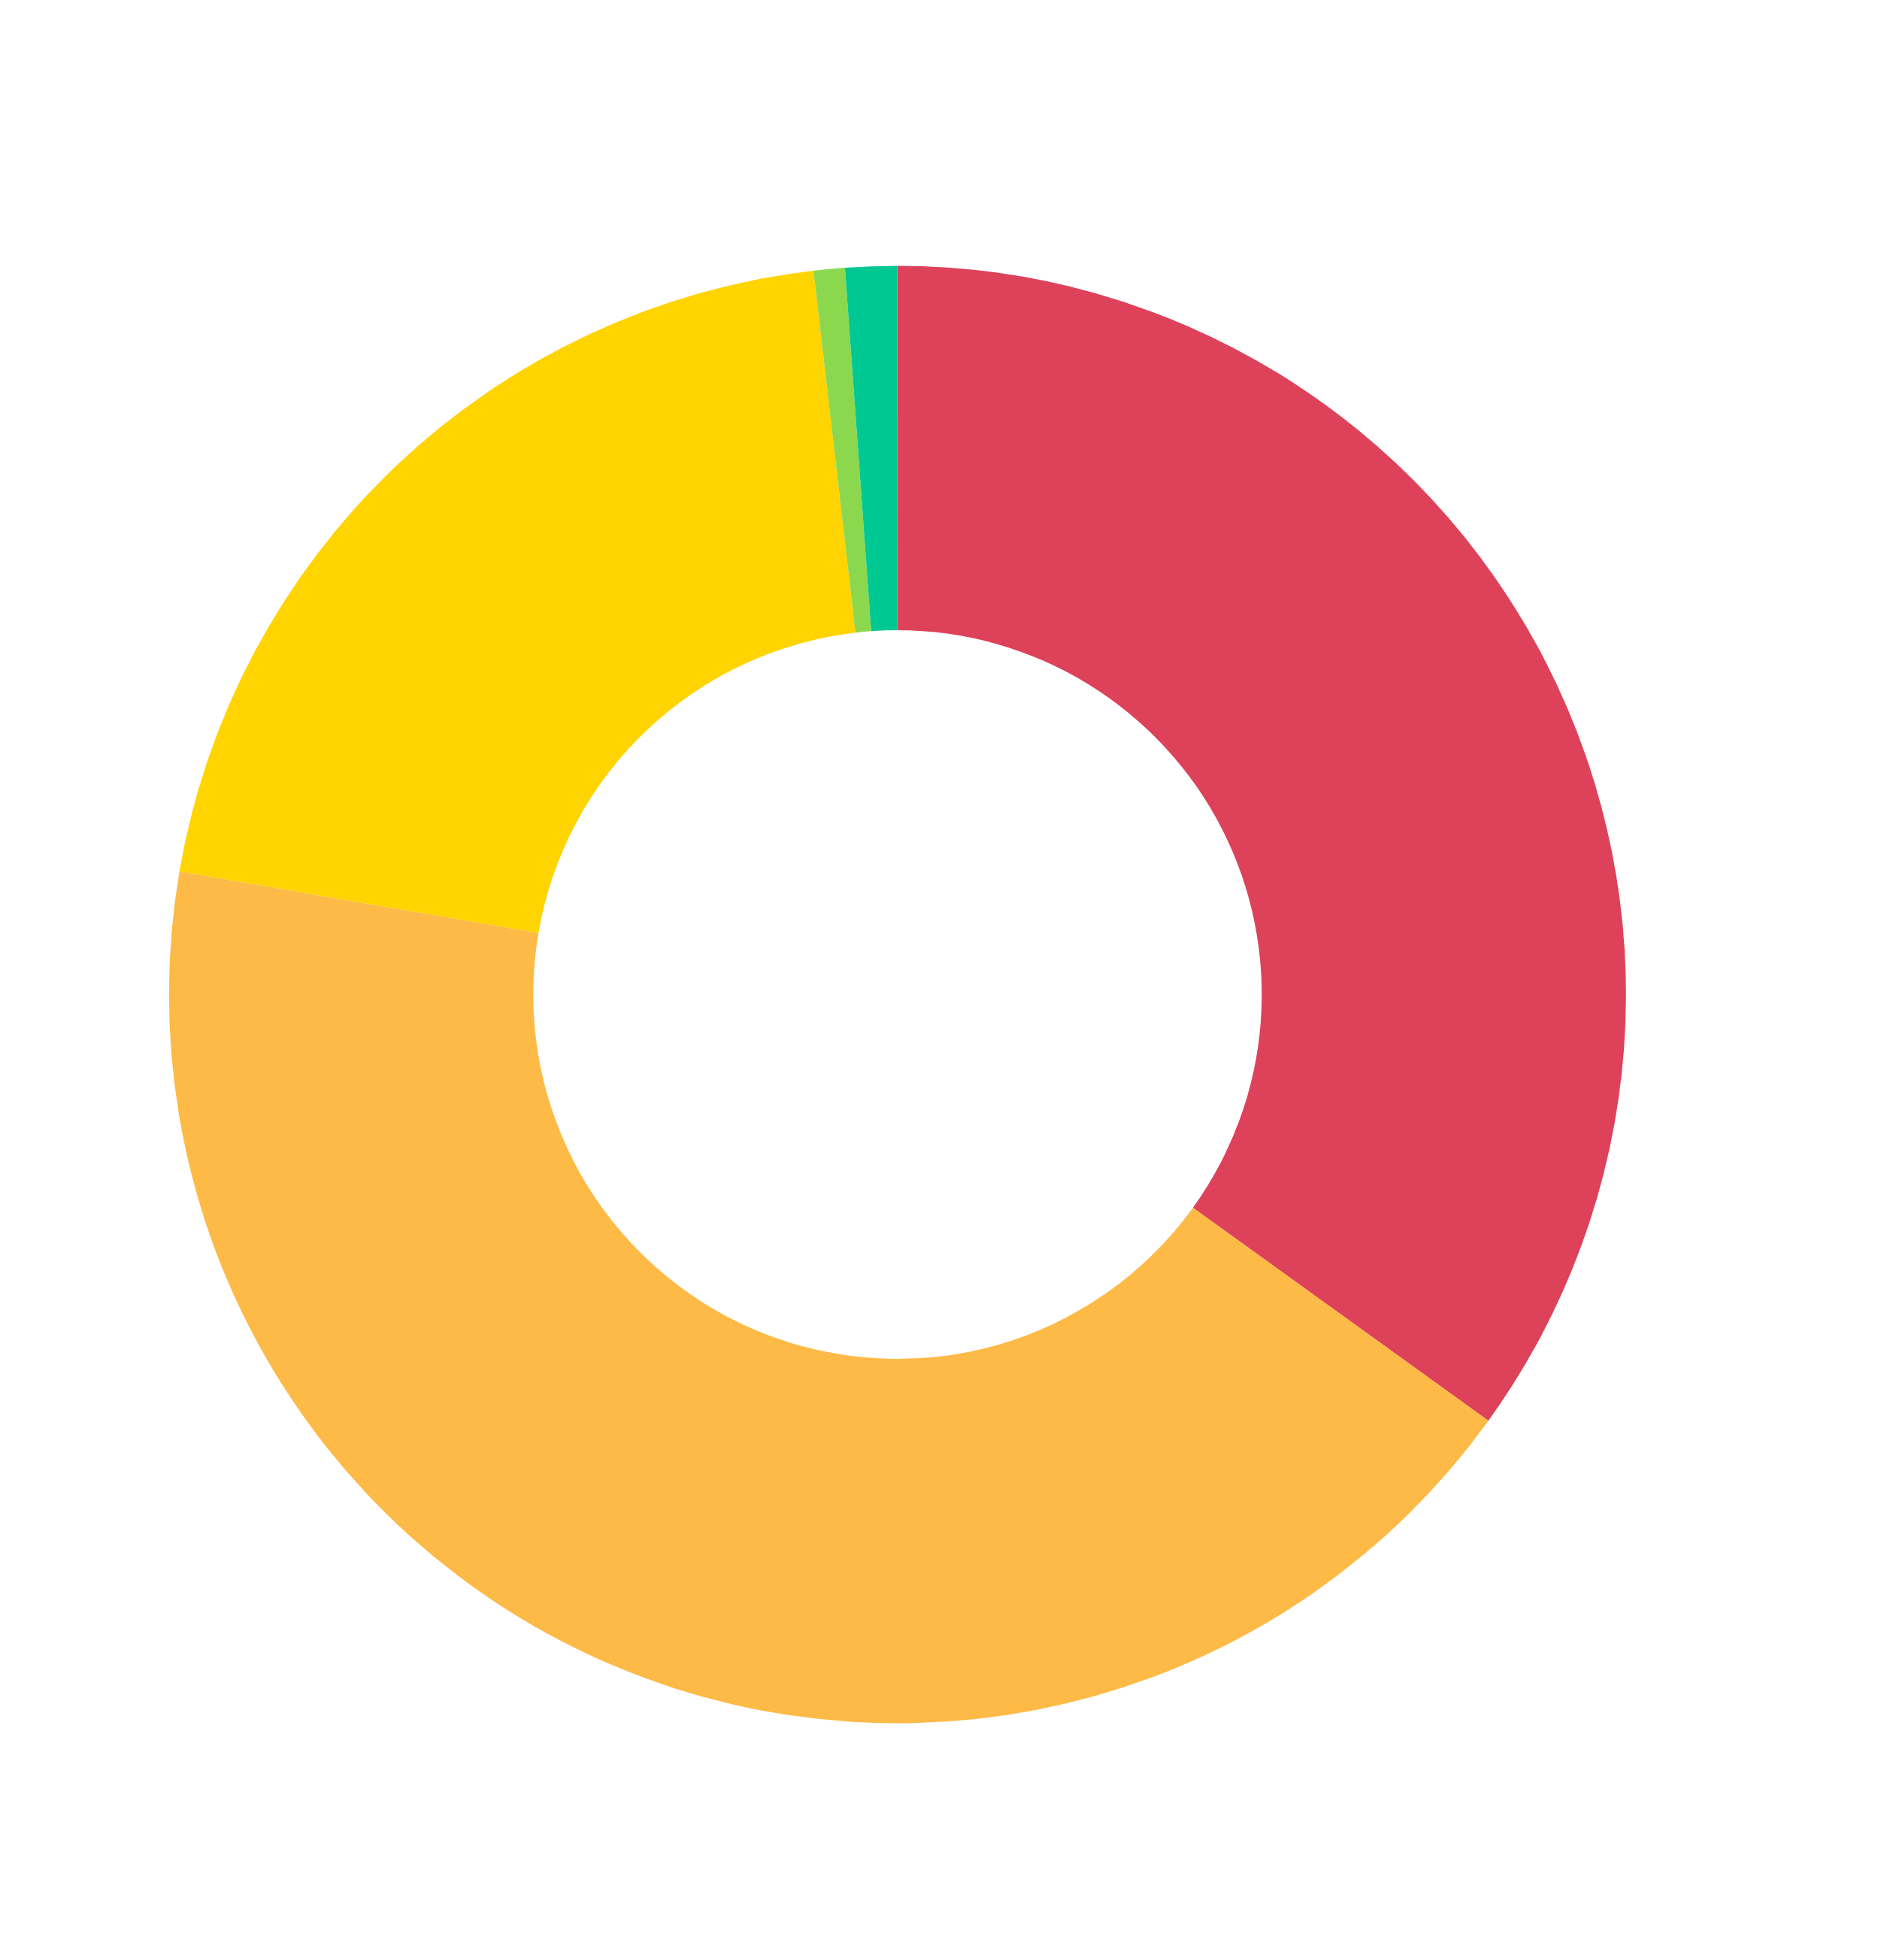
CVSS-B Severity

Slide 39
Just Use CVSS-BT

Slide 40
2025 Known Exploited Vulnerabilities
CVSS-B Severity
CVSS-BT Severity

Slide 41
EPSS Signal For Emerging Threats

Slide 42
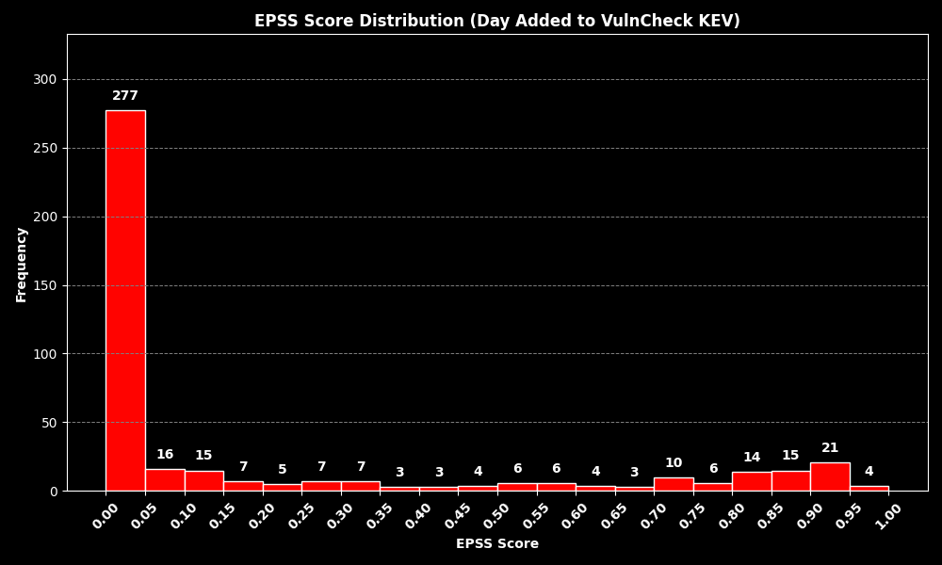
EPSS Score on Day Exploitation Evidence Reported

Slide 43
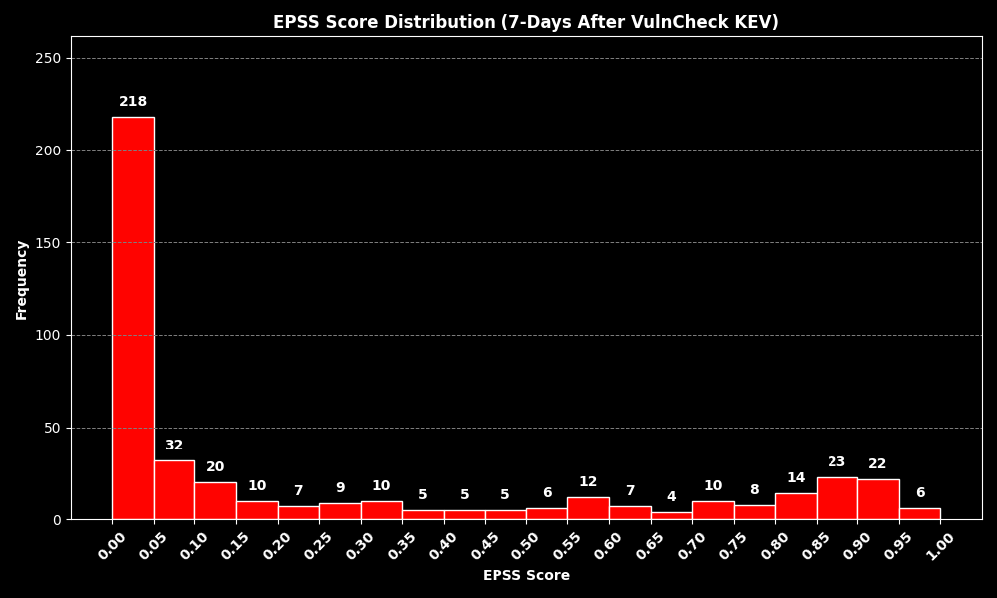
EPSS Score 7-Days After Exploitation Evidence Reported

Slide 44
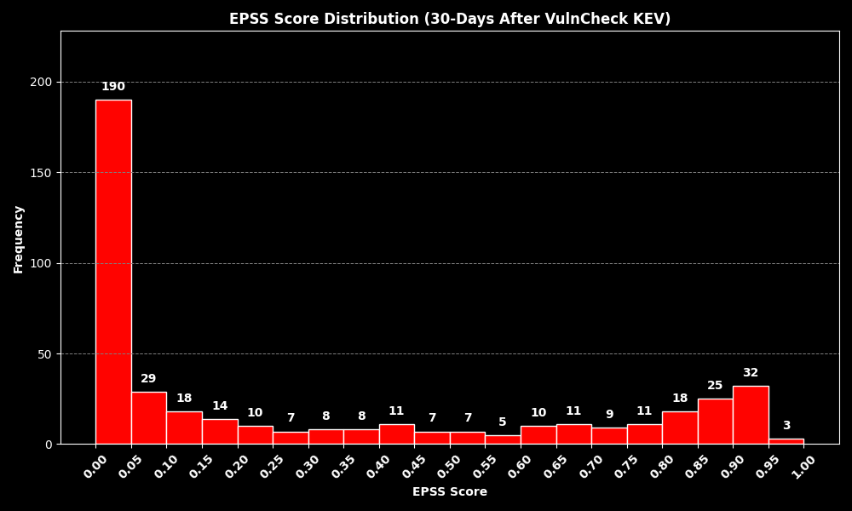
EPSS Score 30-Days After Exploitation Evidence Reported

Slide 45
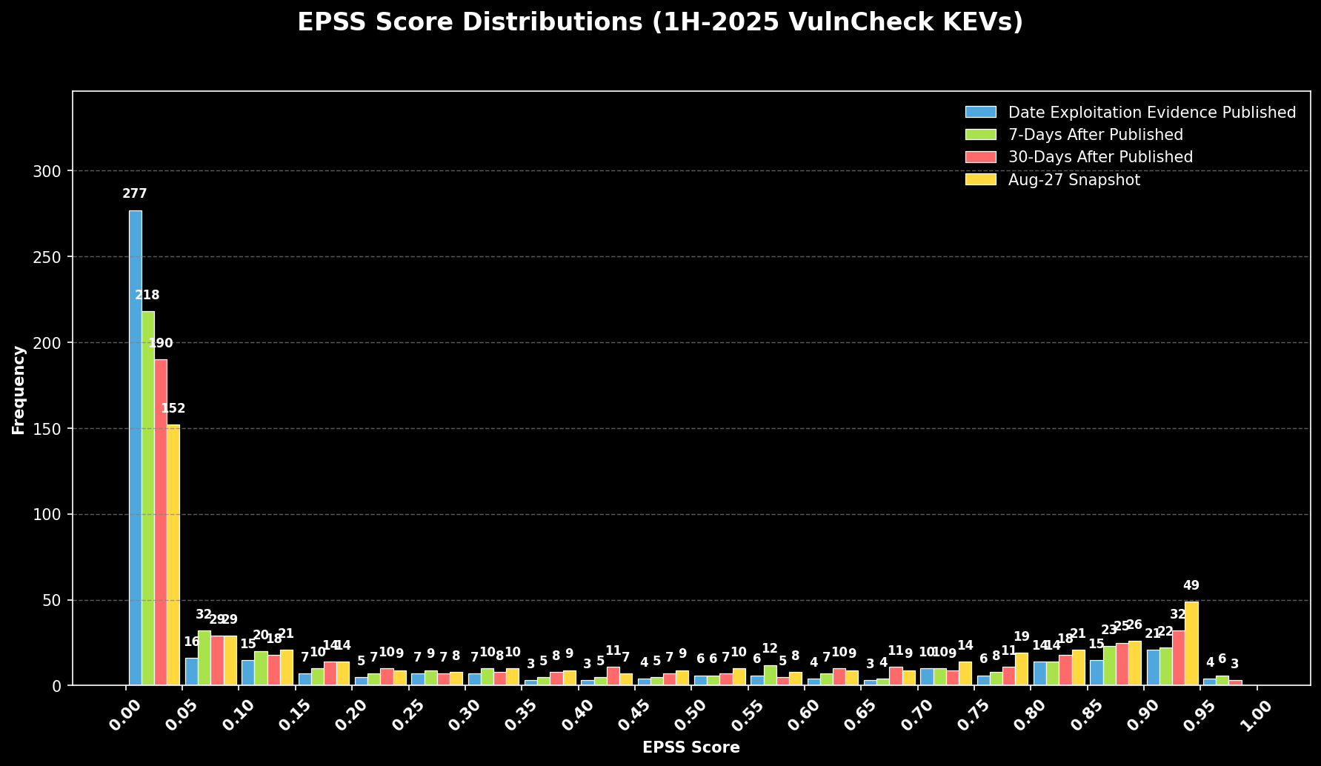
EPSS Score End of August

Slide 46
Defender Considerations for Emerging Threats

Slide 47
As a Consumer, become knowledgable in the limitations of scoring systems and cautious on becoming overly dependent on sources that you are not continually monitoring and analyzing and intimately understand how and if they are working.

Slide 48
Act on available evidence of exploitation, weaponization and other exploit evidence with a sense of urgency...
Cyber Reslience Act Requires*
Exploitation Disclosure in 24-hours
Notify Customers within 72-hours

Slide 49
Decision Tree Frameworks including SSVC / Risk Based Prioritization (Chris Madden) provides a foundation framework for prioritizing vulnerabilities using broader context.

Slide 50
Other Considerations for Defenders

Slide 51
Emerging Threat
Vulnerability Debt
Vulnerability Debt
Rapid Response
Internet Facing
End User Interaction
Remotely Exploitable
Root Cause Analysis
Improve Patch Management
Implement Best Practices
Prune Unused / EOL
Mitagating Controls

Slide 52
Vulnerability Threat Matrix
Ransomware
Botnet
Known Exploited
Threat Actor (APT)
Unattributed KEV
Weaponized
Exploit Availability
Proof-of-Concept
All Other CVEs
Notes:
Exploited by Threat Actors who previously targeted my Organization
Exploited by Threat Actors who previously targeted similar Organizations
Exploited by Threat Actors (APT, Ransomware, Botnets)
Known Exploited In-the-Wild (ITW) [i.e., exploited by unknown parties]
Exploit Weaponization (i.e., in MetaSploit, in commercial or public/private Exploit Kits)
Exploit Proof of Concept Code available (RCE, LPE)
Code available that crashes the service
Very recent CVE (past week) which is very similar to past CVEs that are above (i.e., QNAP Command Injection released)
All CVEs

Slide 53
Thank You!

Slide 54
Appendix

Slide 55
NIST NVD

Slide 56
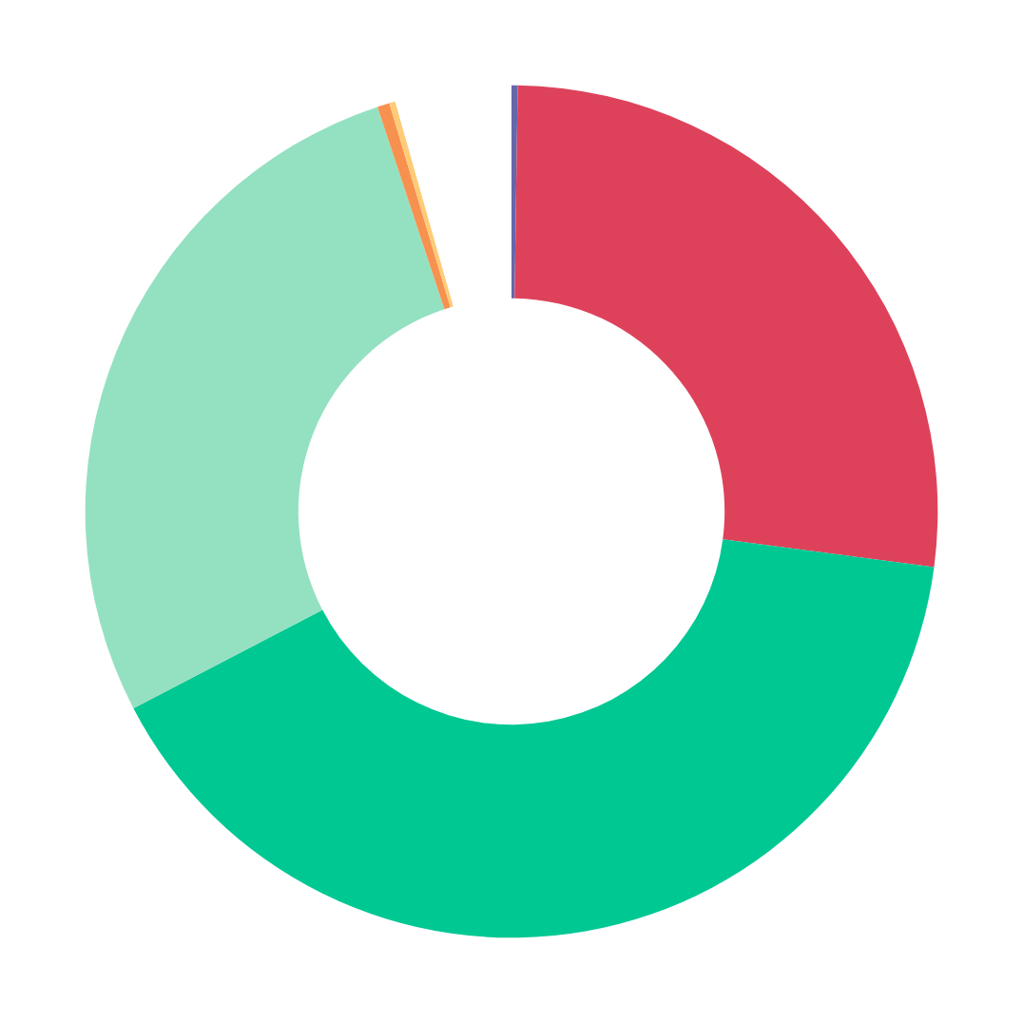
Known Exploited Vulnerabilities by NVD Status (1H-2025)
Reserved
.2%
Deferred
4.4%
Undergoing
Analysis
.2%
Rejected
.4%
Awaiting
Analysis
26.9%
Modified
27.5%
432
KEVs
Analyzed
40.3%

